Slide 1


Envisioning Sustainable Futures in Science Fiction Film
Jeffrey Barber, Integrative Strategies Forum
Escape Velocity, Washington, DC
May 27, 2018
Notes:
1. Hi, I’m Jeffrey Barber, President of Integrative Strategies Forum, a non-profit organization based in Silver Spring, Maryland. This presentation is entitled: Envisioning Sustainable Futures in Science Fiction Film.

Slide 2
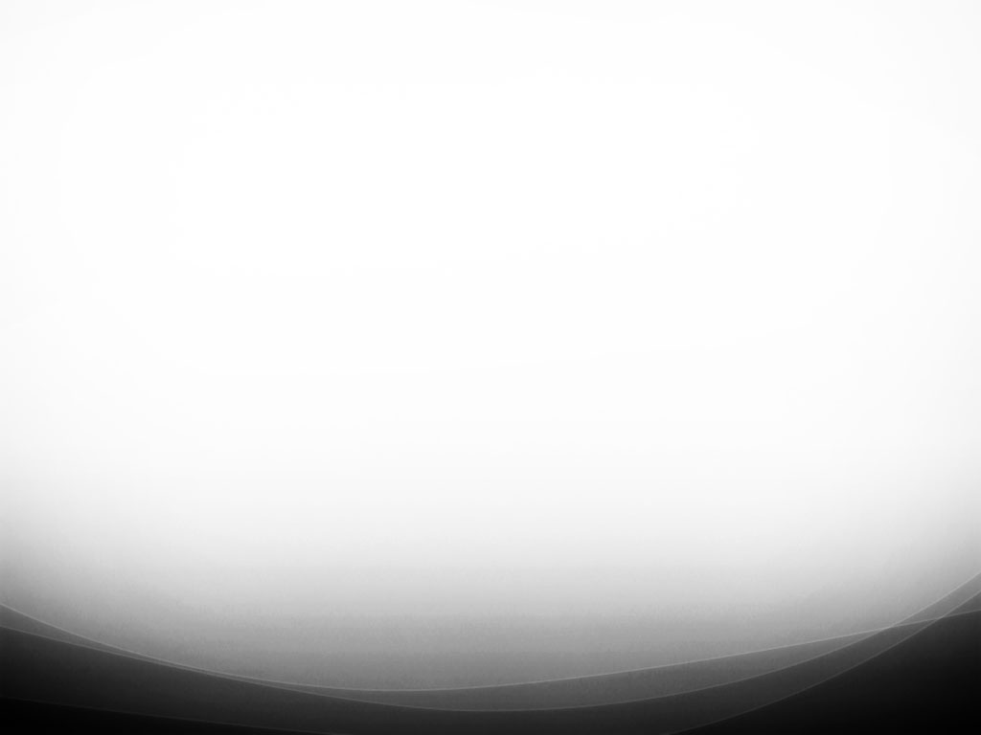
Two questions
How does science fiction literature and cinema portray and explore transitions to sustainability?
Can sustainable future fiction help lessen and possibly reverse the destructive future impacts of today’s unsustainable practices and policies?
Notes:
2. In this presentation we consider two basic questions:
How does fiction literature and cinema portray and explore transitions to sustainability?
How can sustainable future fiction help lessen and possibly reverse the destructive impacts of today’s unsustainable practices and policies?

Slide 3
Sustainability and the future
Notes:
n/a

Slide 4
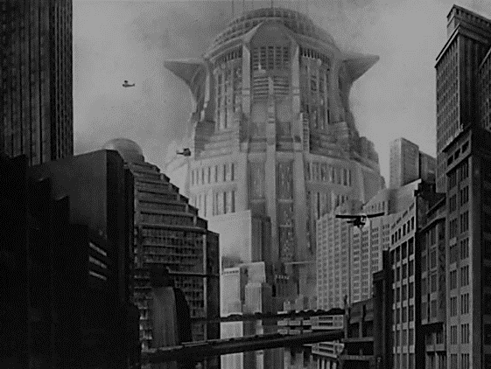
“We are now living in a science fiction novel we are all writing together”
- Kim Stanley Robinson
Notes:
4. “We are now living in a science fiction novel we are all writing together”
- Kim Stanley Robinson
As this quote implies, we are each engaged in a collective process of shaping the future, a global and personal narrative encompassing hopes and dreams, fears and conflict embodied in a wide-ranging and diverse cast of characters.

Slide 5
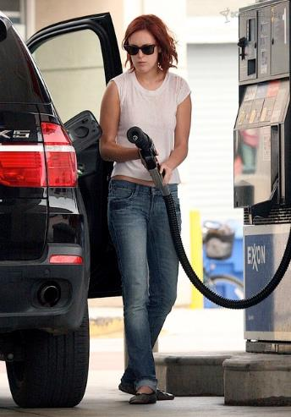
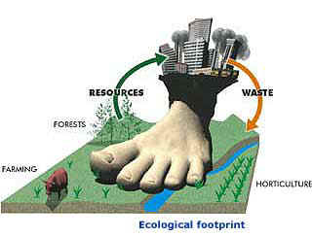
Ecological footprint
Notes:
5. In this collective writing process, each of us are obliged to reflect on the consequences of our choices and actions within the global story.

Slide 6

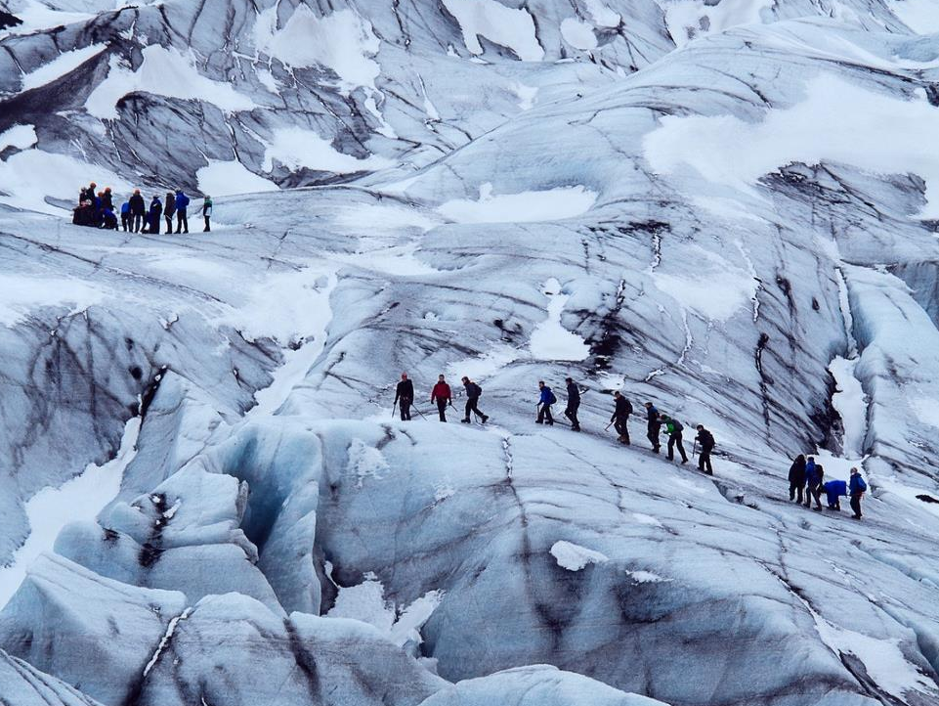
Notes:
6. Although we experience the world and act in it as individuals, we are social creatures; our behavior, values, views and identities…
… are interlinked with those other individuals and communities which give our actions, views and lives meaning.

Slide 7
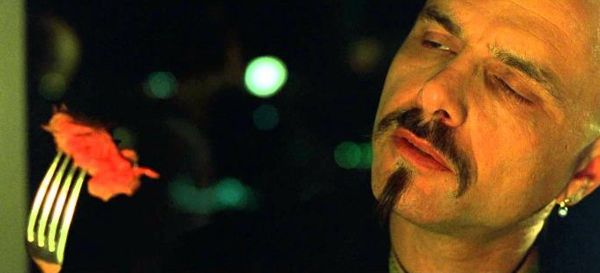
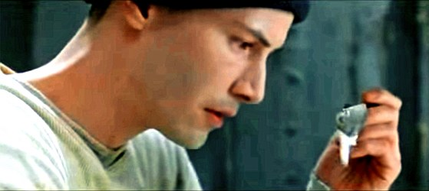
Source: The Matrix (1999)
Notes:
7. As character and author in this global narrative, we need to reflect not only on our personal desires and commitments, but also the ultimate consequences of those choices we make and actions we take.

Slide 8
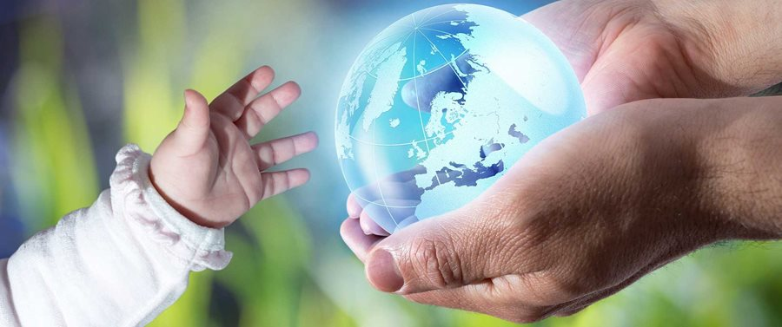
Curse or gift of love?
Notes:
8. Because for future generations those actions can be a regrettable curse … or a gift of love.

Slide 9
Sustainability and science fiction
Notes:
n/a

Slide 10
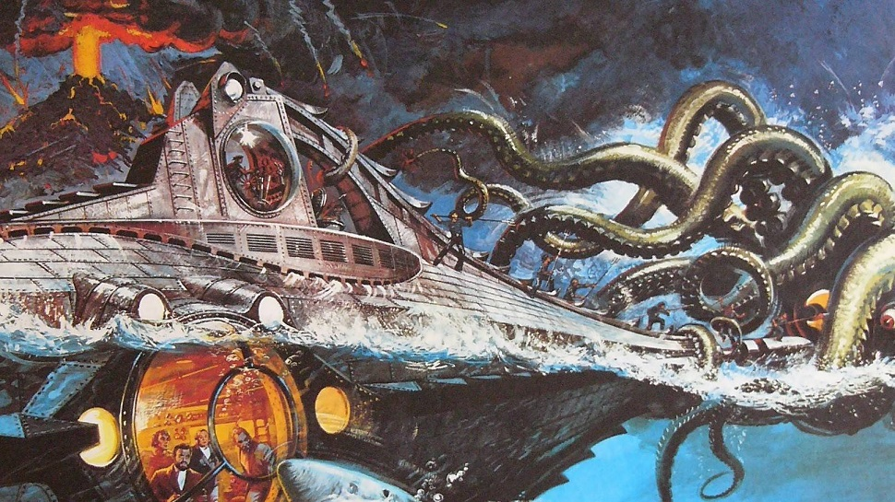
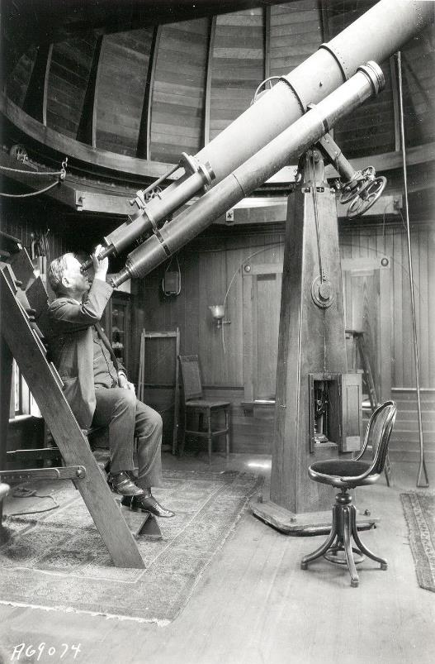
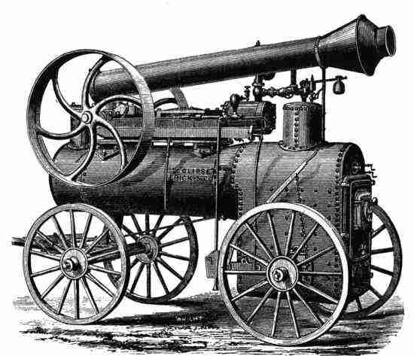
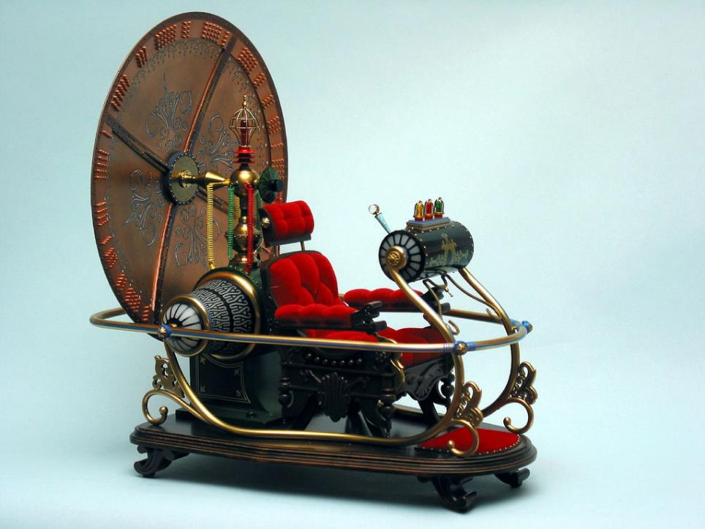
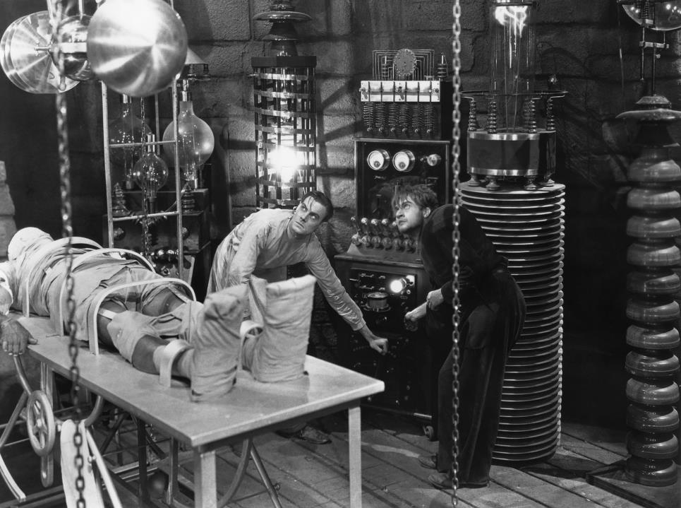

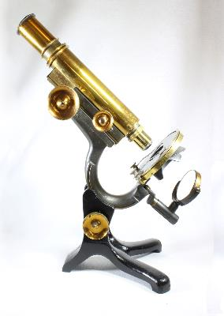
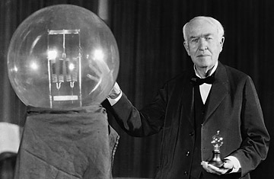
Notes:
10. Whether you mark the beginning of science fiction with Mary Shelly’s Frankenstein, [-] H.G. Wells’ Time Machine or [-] Jules Verne’s fantastic voyages, these stories all share far-sighted reflections on the possibilities and consequences of humanity’s choices and actions in the quest for scientific knowledge, manifested and amplified through technology and industry.

Slide 11
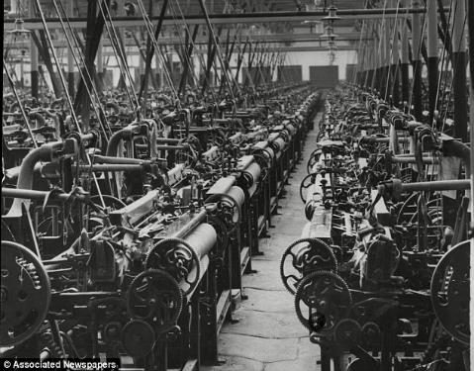
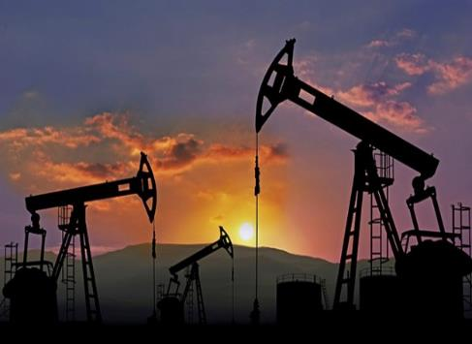
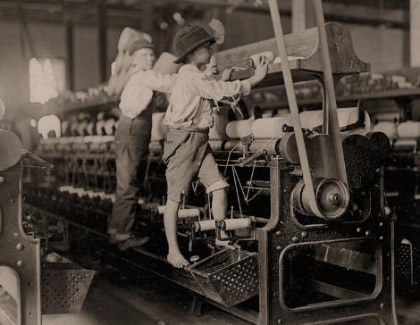
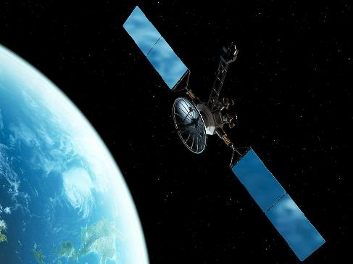
Notes:
11. Science fiction is itself a product of the modern era’s scientific and industrial revolutions. It is also a fitting lens to assess and critique these developments of the modern era, its meaning within the wider Anthropocene, and their social and environment impacts.

Slide 12
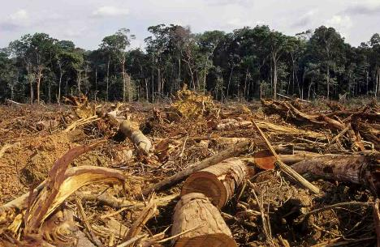
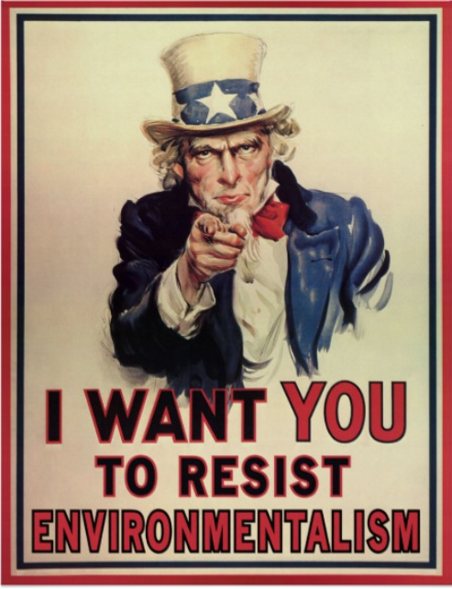
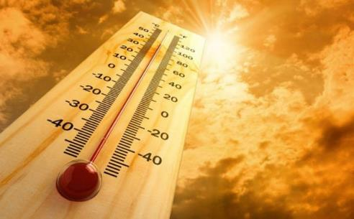
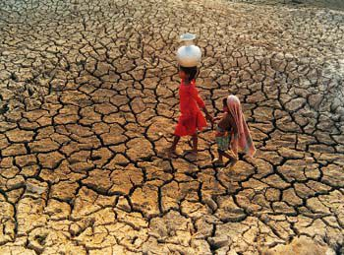
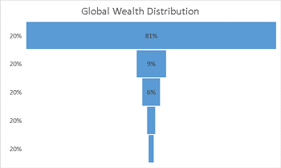
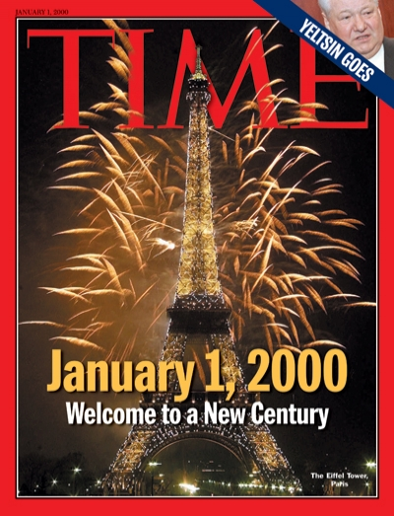
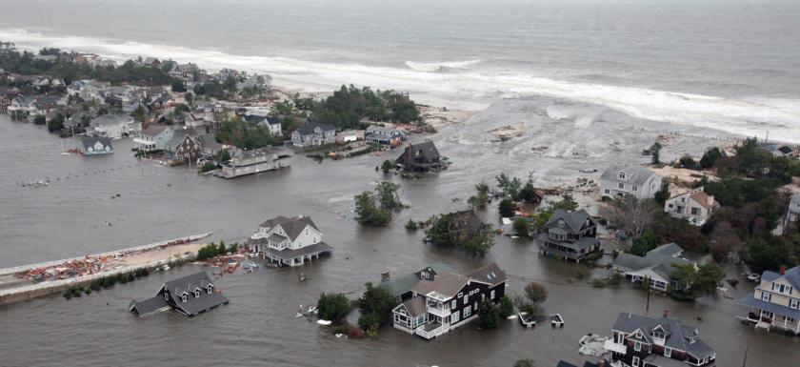
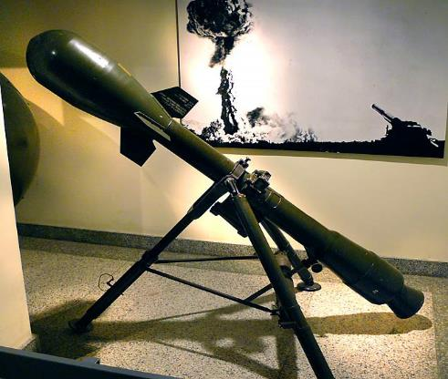
Notes:
12. The world of the new millennium faces an alarming number of those impacts: global warming, desertification and fresh water scarcity, rising sea levels and flooding [-] economic inequality, biodiversity loss and ecological decline, propagation and trade of increasingly sophisticated weapons of destruction, as well as propaganda justifying and thus deepening those impacts.

Slide 13
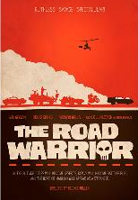
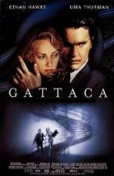
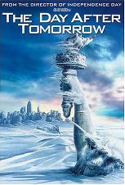
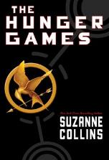
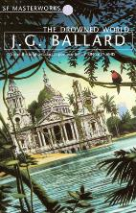
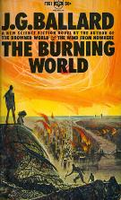
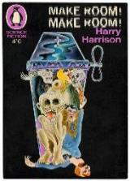
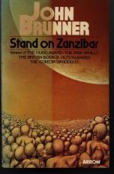
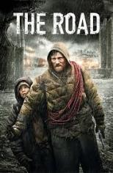
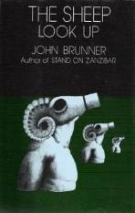
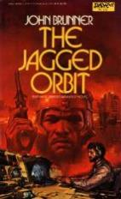
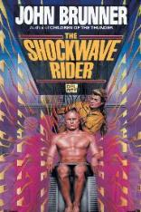
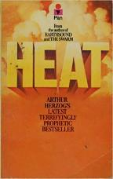
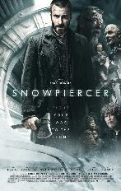

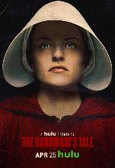
Exploring threats
1982
1997
2004
2008
1962
1964
1966
1968
2015
1977
2009
1972
2017
1969
2013
1975
Notes:
13. Science fiction has, in turn, responded to many of these threats and challenges, providing not only public attention and social critique but also the personal experience of what it might be like to face these threats up close. [-]
The question, however, is: To what degree does science fiction explore not just the threats but possible solutions and alternatives to today’s crises? That is, how far has science fiction embraced the challenge of imagining transitions to sustainable futures?

Slide 14

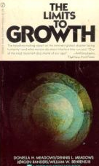
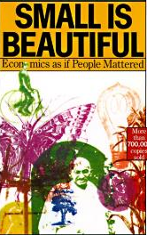
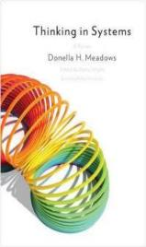
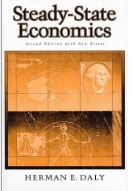
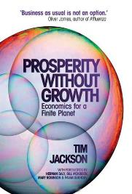
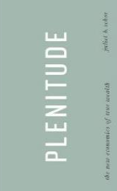
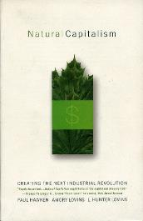
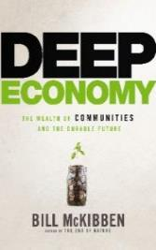

What is “sustainability”?
Notes:
14. There are a lot of different definitions of sustainability. This is a concept about how we shape our future, about how our choices and actions in meeting our particular needs affect the lives of others, including future generations.

Slide 15



Notes:
15. It is not simply about protecting the environment but also ensuring social equity, specifically the goal to achieve “a higher quality of life for all people”.

Slide 16

Notes:
16. Although it is a complex and contested concept, sustainability nevertheless provides a constructive framework in the search for solutions to the planet’s increasingly “wicked” problems. It also offers a frame for “thought experiments” for imagining alternative futures.

Slide 17
Dystopia and apocalypse
Notes:
n/a

Slide 18









Slide 19








Classic dystopian novels
1924
1932
1935
1949
1953
1953
1957
1962

Slide 20









Cyberpunk
1957
1968
1973
1975
1982
1984
1986
1986
1989
1991

Slide 21








Post-cyberpunk
1986
1986
1992
1992
1997
2009
2011
2012

Slide 22








Classic dystopian films
1956
1959
1962
1966
1965
1968
1983
1983

Slide 23









Neo-classic dystopian films
1971
1972
1973
1976
1982
1984
1990
1996
1998
1999

Slide 24









Contemporary dystopian films
2004
2004
2006
2009
2012
2014
2014
2014
2017
2018

Slide 26
Imagining sustainability transitions

Slide 27


Slide 28


Slide 29






Classic utopias
381 B.C.
1516
1890
1888
1905
1915
Notes:
The concept of “utopia” gets a lot of bad press, being closely identified with dystopia – as if the one automatically leads into the other. However, for our purposes, Ruth Levitas provides a more productive definition.

Slide 30







Notes:
One of the difficulties with utopia is that, rather than an inspiration, they are more often distrusted, seen as dystopias in disguise, lures to draw in the naïve, who are then be betrayed and exploited.

Slide 31
“Utopia is about how we would live
and what kind of a world we would live in if we could do just that.”
- Ruth Levitas, The Concept of Utopia

Slide 32



Slide 33



Critical utopian scenarios
1974
1975
1976
Notes:
You may be familiar with some of these contemporary utopian scenarios.

Slide 34




Sustainable transition narratives
1990
1992, 1993, 1996
2015
2017
Notes:
You may be familiar with some of these contemporary utopian scenarios.

Slide 35



Slide 36







Slide 37

“One of the few science fiction universes
that grapple with the idea that money
may someday become obsolete…”
- Manu Saadia
Notes:
The post-scarcity economics of Star Trek is especially interesting, which Manu Saadia examined in his book Trekonomics.

Slide 38
“We’ve overcome hunger and greed,
and we’re no longer interested
in the accumulation of things.”
- Jean-Luc Picard

Slide 39

We don’t have a Replicator
Notes:
The problem with the Star Trek utopia is that it is dependent on technology that does not exist, that is more fantasy than science. It did not evolve through adherence to ecological principles and practices.

Slide 40



The Culture

Slide 41


Slide 42

The Culture
Iain M. Banks (1954-2015)

Slide 43




Octavia Butler (1947-2006)
1979
1993
1998

Slide 44



Xenogenesis series
1987
1989
1989

Slide 45

Dawn

Slide 46

Star Trek Discovery

Slide 47


Slide 48


Slide 49

Notes:
As part of this Sustainable Lifestyles Research Initiative we have set out on a journey to examine some of the different genres and productions of literature and film we might describe as “Sustainable Futures Fiction”.

